Slide 1
CS F320 Foundations of data scienCe
Assignment #1 Presentation Template
Group #8
Group Details (2017B2A10548P –VISHESH MANGLA)

Slide 2
Problem Statement
THE MONEYBALL CASE STUDY
Sabermetrics: DePodesta, a graduate in Economics from Harvard University joined the A’s in 1999 and quickly started incorporating analysis of baseball statistics to value and purchase players. Dataset: Use the Moneyball dataset available at Kaggle.
Implement all your models in R.

Slide 3
Datasets used
Dplyr: Easy data manupulation
Ggplot: Plotting module

Slide 4
Data Description
Dataset downloaded from Sean Lahman’s website:
http://www.seanlahman.com/baseball-archive/statistics/
2012 dataset
Used Batting.csv and Salaries.csv

Slide 5
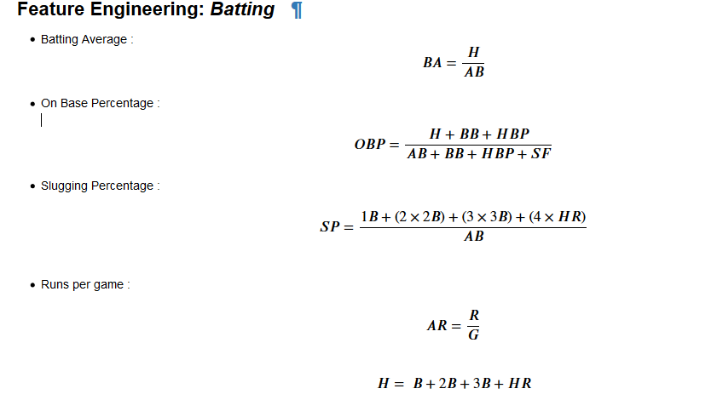
Sabermetrics

Slide 6
Techniques used for identifying players
How to choose players - Algorithm
We iterate through the rows picking 3 rows at a time and then multiplying number of games offered to the three lost players to corresponding players in batters_pool(the three rows) by multiplying max games to player with highest OBP,and then SP since OBP determine the ability of the player to remain at base and stay longer in game.
Code in jupyter

Slide 7
results
Logistic regression seems to be what is to be used here which gives high accuracy of 98% but problem is with F1 Score.

Slide 8
Will the Identified player join?
Based on the “few data points” which I chose no complete (3 character tuple) matched in correctly classified points.

Slide 9
Submit your presentation and R code to Dr. vishal gupta through mail Deadline: 06th April, 2019
Subject line: Group #8

